Slide 1
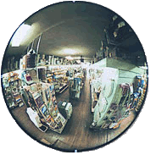


Ray Diagrams

Slide 2
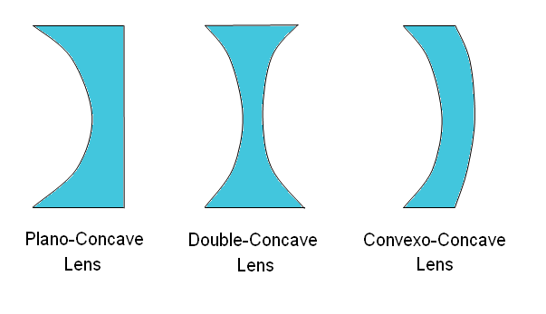
Diverging Lens = Concave

Slide 3
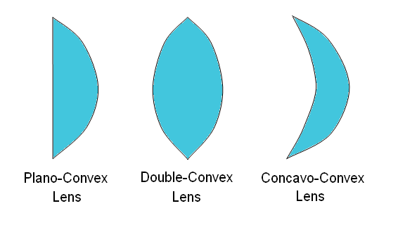
Converging Lens = Convex

Slide 4
A ray of light is an extremely narrow beam of light.

Slide 5
All visible objects emit or reflect light rays in all directions.

Slide 6
Our eyes detect light rays.

Slide 7
We see images when
light rays
converge in our eyes.
converge: come together

Slide 8

Mirrors
It is possible to see images in mirrors.
image
object

Slide 9

Reflection
(bouncing light)
Reflection is when light changes direction by bouncing off a surface.
When light is reflected off a mirror, it hits the mirror at the same angle (the incidence angle, θ_{i}) as it reflects off the mirror (the reflection angle, θ_{r}).
The normal is an imaginary line which lies at right angles to the mirror where the ray hits it.
normal
reflected ray
incident ray
θ_{r}
θ_{i}
Mirror

Slide 10
Lensmaker’s Equation
  ƒ = focal length
  d_{o} = object distance
  d_{i} = image distance
  if distance is negative the image is behind the mirror

Slide 11
Magnification Equation
  m = magnification
  h_{i} = image height
  h_{o} = object height
  If height is negative the image is upside down
  if the magnification is negative
  the image is inverted (upside down)

Slide 12

Refraction
(bending light)
Refraction is when light bends as it passes from one medium into another.
When light traveling through air passes into the glass block it is refracted towards the normal.
When light passes back out of the glass into the air, it is refracted away from the normal.
Since light refracts when it changes mediums it can be aimed. Lenses are shaped so light is aimed at a focal point.
normal
θ_{i}
air
glass block
θ_{r}
θ_{i}
θ_{r}
air
normal

Slide 13



Lenses
The first telescope, designed and built by Galileo, used lenses to focus light from faraway objects, into Galileo’s eye. His telescope consisted of a concave lens and a convex lens.
light from object
convex lens
concave lens
Light rays are always refracted (bent) towards the thickest part of the lens.

Slide 14
Rules for Concave Lens (Divergence)
An incident ray traveling parallel to the principal axis of a diverging lens will refract through the lens and travel in line with the focal point.
An incident ray traveling towards the focal point on the way to the lens will refract through the lens and travel parallel to the principal axis.
An incident ray that passes through the center of the lens will in affect continue in the same direction that it had when it entered the lens.

Slide 15
Concave Lenses
Concave lenses are thin in the middle and make light rays diverge (spread out).
•
F
optical axis
If the rays of light are traced back (dotted sight lines), they all intersect at the focal point (F) behind the lens.

Slide 16
Concave Lenses
•
F
optical axis
The light rays behave the same way if we ignore the thickness of the lens.
Light rays that come in parallel to the optical axis diverge from the focal point.
Notes:
When doing geometric optics problems it is much simpler to draw the lens/mirror as a line so that the light relects/refracts at the line. This saves us from having to show the lights behavior inside the lens.

Slide 17
Concave Lenses
•
F
optical axis
Light rays that come in parallel to the optical axis still diverge from the focal point.

Slide 18
Concave Lens
(example)
•
F
optical axis
The first ray comes in parallel to the optical axis and refracts from the focal point.

Slide 19
Concave Lens
(example)
•
F
optical axis
The first ray comes in parallel to the optical axis and refracts from the focal point.
The second ray goes straight through the center of the lens.

Slide 20
Concave Lens
(example)
•
F
optical axis
The first ray comes in parallel to the optical axis and refracts from the focal point.
The second ray goes straight through the center of the lens.
The light rays don’t converge, but the sight lines do.

Slide 21
Concave Lens
(example)
•
F
optical axis
The first ray comes in parallel to the optical axis and refracts from the focal point.
The second ray goes straight through the center of the lens.
The light rays don’t converge, but the sight lines do.
A virtual image forms where the sight lines converge.

Slide 22
Your Turn
(Concave Lens)
object
•
F
optical axis
concave lens
Note: lenses are thin enough that you just draw a line to represent the lens.
Locate the image of the arrow.

Slide 23
Your Turn
(Concave Lens)
object
•
F
image
optical axis
concave lens
Note: lenses are thin enough that you just draw a line to represent the lens.
Locate the image of the arrow.

Slide 24
Rules for Convex Lens (Convergence)
An incident ray traveling parallel to the principal axis of a converging lens will refract through the lens and travel through the focal point on the opposite side of the lens.
An incident ray traveling through the focal point on the way to the lens will refract through the lens and travel parallel to the principal axis.
An incident ray that passes through the center of the lens will continue in the same direction that it had when it entered the lens.

Slide 25
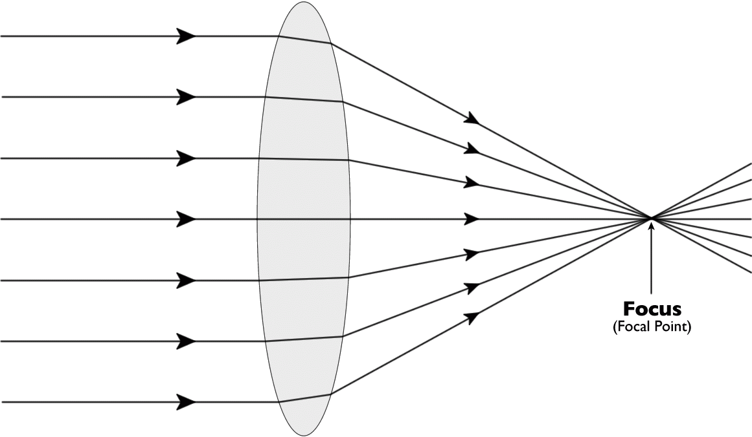
Convex Lenses
Convex lenses are thicker in the middle and focus light rays to a focal point in front of the lens.
The focal length of the lens is the distance between the center of the lens and the point where the light rays are focused.

Slide 26
Convex Lenses
•
F
optical axis

Slide 27
Convex Lenses
•
F
optical axis
Light rays that come in parallel to the optical axis converge at the focal point.

Slide 28
Convex Lens
(example)
•
F
optical axis
The first ray comes in parallel to the optical axis and refracts through the focal point.

Slide 29
Convex Lens
(example)
•
F
optical axis
The first ray comes in parallel to the optical axis and refracts through the focal point.
The second ray goes straight through the center of the lens.

Slide 30
Convex Lens
(example)
•
F
optical axis
The first ray comes in parallel to the optical axis and refracts through the focal point.
The second ray goes straight through the center of the lens.
The light rays don’t converge, but the sight lines do.

Slide 31
Convex Lens
(example)
•
F
optical axis
The first ray comes in parallel to the optical axis and refracts through the focal point.
The second ray goes straight through the center of the lens.
The light rays don’t converge, but the sight lines do.
A virtual image forms where the sight lines converge.

Slide 32
Your Turn
(Convex Lens)
optical axis
image
object
•
F
convex lens
Note: lenses are thin enough that you just draw a line to represent the lens.
Locate the image of the arrow.

Slide 33
Your Turn
(Convex Lens)
optical axis
image
object
•
F
convex lens
Note: lenses are thin enough that you just draw a line to represent the lens.
Locate the image of the arrow.

Slide 34
Thanks/Further Info
Faulkes Telescope Project: Light & Optics by Sarah Roberts
Fundamentals of Optics: An Introduction for Beginners by Jenny Reinhard
PHET Geometric Optics (Flash Simulator)
Thin Lens & Mirror (Java Simulator) by Fu-Kwun Hwang

